Slide 1

236781
Lecture 5
Deep learning
Object Detection
Dr. Chaim Baskin

Slide 2
Announcements and reminders
Assignment 2 due tonight
Quiz 2 to be available 9AM tomorrow through 9AM Saturday, March 11th
Covers bias-variance tradeoff through PyTorch tutorial
4-credit project proposals due this Friday, March 10th
Progress update will be due in early April

Slide 3
Object detection
Image source

Slide 4
What are some challenges of object detection?
Image source
Images may contain more than one class, multiple instances from the same class
Bounding box localization
Evaluation

Slide 5
Outline
Task definition and evaluation
Two-stage detectors:
R-CNN
Fast R-CNN
Faster R-CNN
Single-stage and multi-resolution detectors
Recent trends

Slide 6
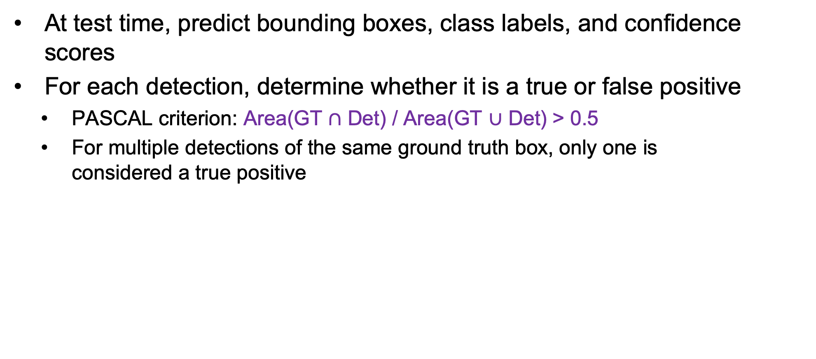
Object detection evaluation
At test time, predict bounding boxes, class labels, and confidence scores
For each detection, determine whether it is a true or false positive
PASCAL criterion: Area(GT $∩$ Det) / Area(GT $∪$ Det) > 0.5
For multiple detections of the same ground truth box, only one is considered a true positive
dog: 0.6
dog
dog: 0.55
cat: 0.8
cat
Ground truth (GT)

Slide 7
Object detection evaluation
At test time, predict bounding boxes, class labels, and confidence scores
For each detection, determine whether it is a true or false positive
For each class, sort detections from highest to lowest confidence, plot Recall-Precision curve and compute Average Precision (area under the curve)
Take mean of AP over classes to get mAP
Precision:
true positive detections / total detections
Recall:
true positive detections / total positive test instances

Slide 8
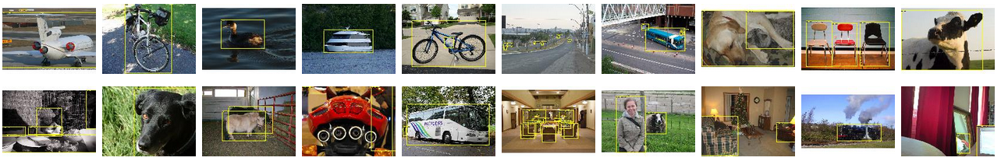
PASCAL VOC Challenge (2005-2012)
20 challenge classes:
Person
Animals: bird, cat, cow, dog, horse, sheep
Vehicles: airplane, bicycle, boat, bus, car, motorbike, train
Indoor: bottle, chair, dining table, potted plant, sofa, tv/monitor
Dataset size (by 2012): 11.5K training/validation images, 27K bounding boxes, 7K segmentations
http://host.robots.ox.ac.uk/pascal/VOC/

Slide 9
Progress on PASCAL detection
PASCAL VOC
Before CNNs
After CNNs

Slide 10
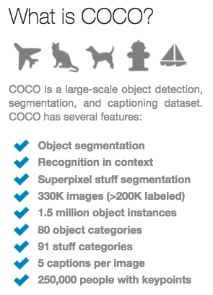
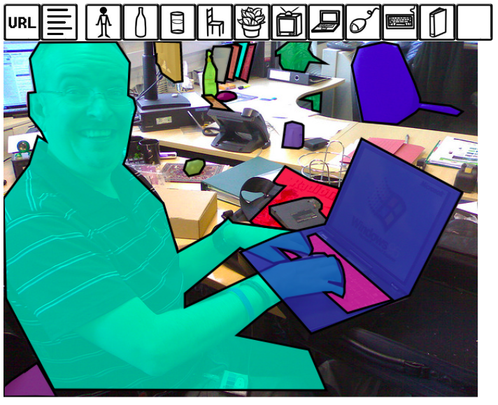
More recent benchmark: COCO
http://cocodataset.org/#home

Slide 11
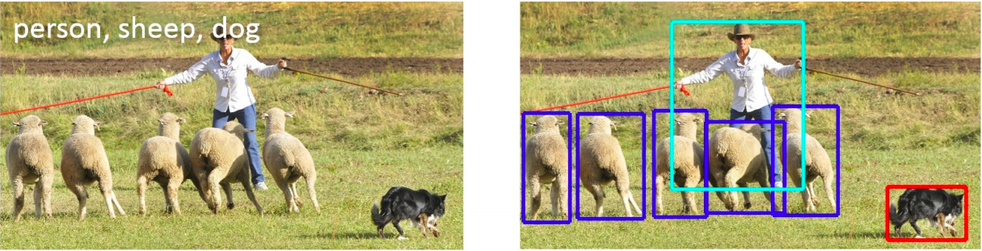
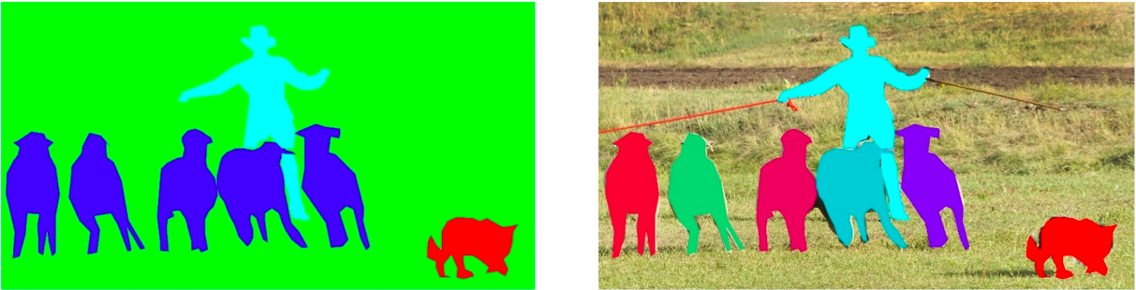
COCO dataset: Tasks
image classification
object detection
semantic segmentation
instance segmentation
Also: keypoint prediction, captioning, question answering…

Slide 12
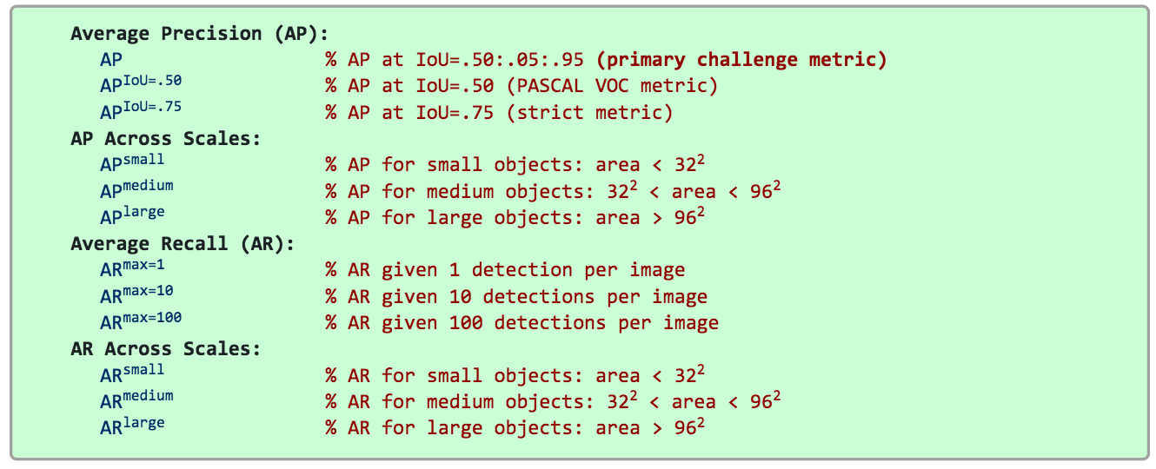
COCO detection metrics
Leaderboard: http://cocodataset.org/#detection-leaderboard
Not updated since 2020

Slide 13
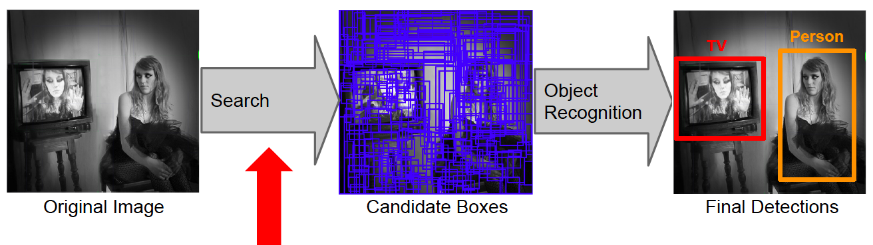
Object detection: Outline
Task definition and evaluation
Two-stage detectors
Proposal Generation
Region Proposals
Image source

Slide 14
R-CNN: Region proposals + CNN features
Source: R. Girshick
SVMs
Classify regions with SVMs
SVMs
ConvNet
SVMs
ConvNet
Forward each region through ConvNet
ConvNet
Warped image regions
Region proposals
Input image
R. Girshick, J. Donahue, T. Darrell, and J. Malik, Rich Feature Hierarchies for Accurate Object Detection and Semantic Segmentation, CVPR 2014
Notes:
The features are also sent to a linear regressor that improves object localization.
The components outlined in purple are “post hoc” in the sense that they are learned after the convnet weights are trained and forever frozen.

Slide 15
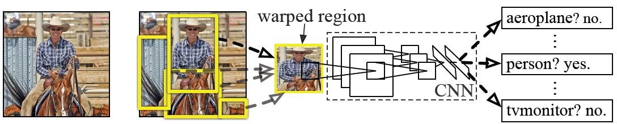
R-CNN details
Regions: ~2000 Selective Search proposals
Network: AlexNet pre-trained on ImageNet (1000 classes), fine-tuned on PASCAL (21 classes)
Final detector: warp proposal regions, extract fc7 network activations (4096 dimensions), classify with linear SVM
Bounding box regression to refine box locations
Performance: mAP of 53.7% on PASCAL 2010 (vs. 35.1% for Selective Search and 33.4% for Deformable Part Models)
Notes:
Object detection system overview. Our system (1) takes an input image, (2) extracts around 2000 bottom-up region proposals, (3) computes features for each proposal using a large convolutional neural network (CNN), and then (4) classifies each region using class-specific linear SVMs. R-CNN achieves a mean average precision (mAP) of 53.7% on PASCAL VOC 2010. For comparison, Uijlings et al. (2013) report 35.1% mAP using the same region proposals, but with a spatial pyramid and bag-of-visual-words approach. The popular deformable part models perform at 33.4%.

Slide 16
R-CNN pros and cons
Pros
Much more accurate than previous approaches!
Any deep architecture can immediately be “plugged in”
Cons
Not a single end-to-end system
Fine-tune network with softmax classifier (log loss)
Train post-hoc linear SVMs (hinge loss)
Train post-hoc bounding-box regressions (least squares)
Training was slow (84h), took up a lot of storage
2000 CNN passes per image
Inference (detection) was slow (47s / image with VGG16)

Slide 17
Fast R-CNN
Softmax classifier
Linear +
softmax
Linear
Bounding-box regressors
FCs
Fully-connected layers
RoI Pooling layer
Region proposals
Conv5 feature map of image
ConvNet
Forward whole image through ConvNet
Source: R. Girshick
R. Girshick, Fast R-CNN, ICCV 2015
Notes:
Rather than using post-hoc bounding-box regressors, bounding-box regression is implemented as an additional linear layer in the network

Slide 18
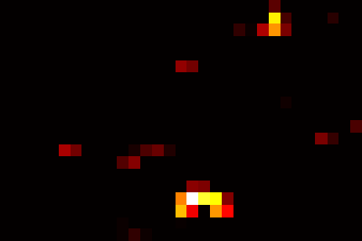
RoI pooling
“Crop and resample” a fixed-size feature representing a region of interest out of the outputs of the last conv layer
Use nearest-neighbor interpolation of coordinates, max pooling
Conv feature map
RoI pooling layer
FC layers …
Region of Interest (RoI)
RoI feature
Source: R. Girshick, K. He

Slide 19
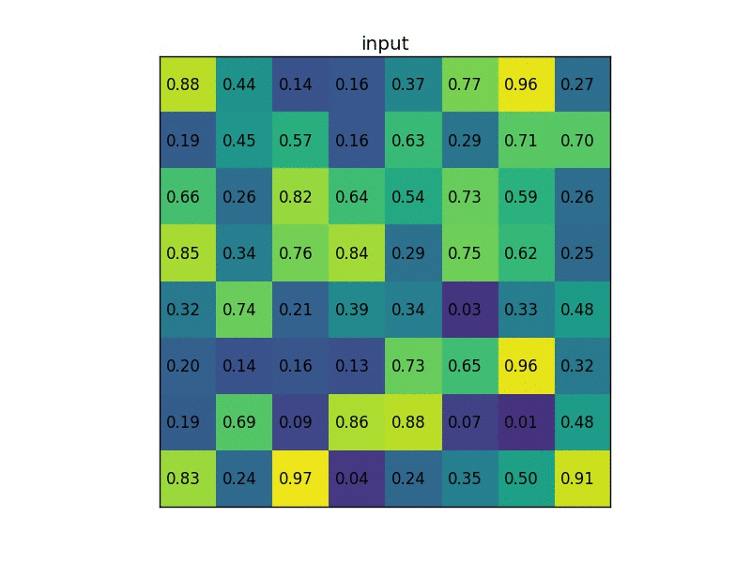
RoI pooling illustration
Image source

Slide 20
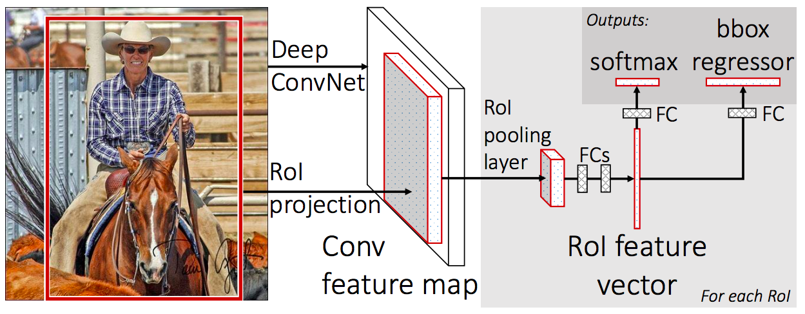
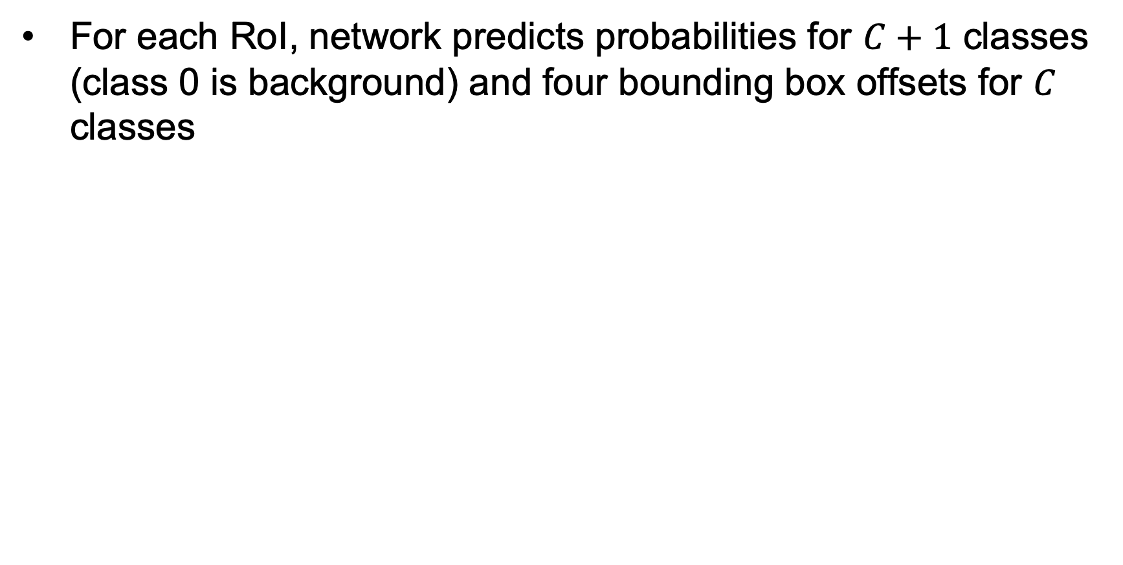
Prediction
For each RoI, network predicts probabilities for $C+1$ classes (class 0 is background) and four bounding box offsets for $C$ classes
R. Girshick, Fast R-CNN, ICCV 2015

Slide 21
Fast R-CNN training
Log loss + smooth L1 loss
Multi-task loss
Linear +
softmax
Linear
FCs
Trainable
ConvNet
Source: R. Girshick
R. Girshick, Fast R-CNN, ICCV 2015
Notes:
Rather than using post-hoc bounding-box regressors, bounding-box regression is implemented as an additional linear layer in the network

Slide 22
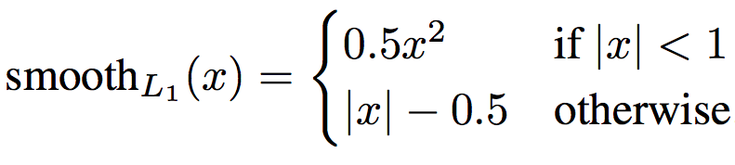
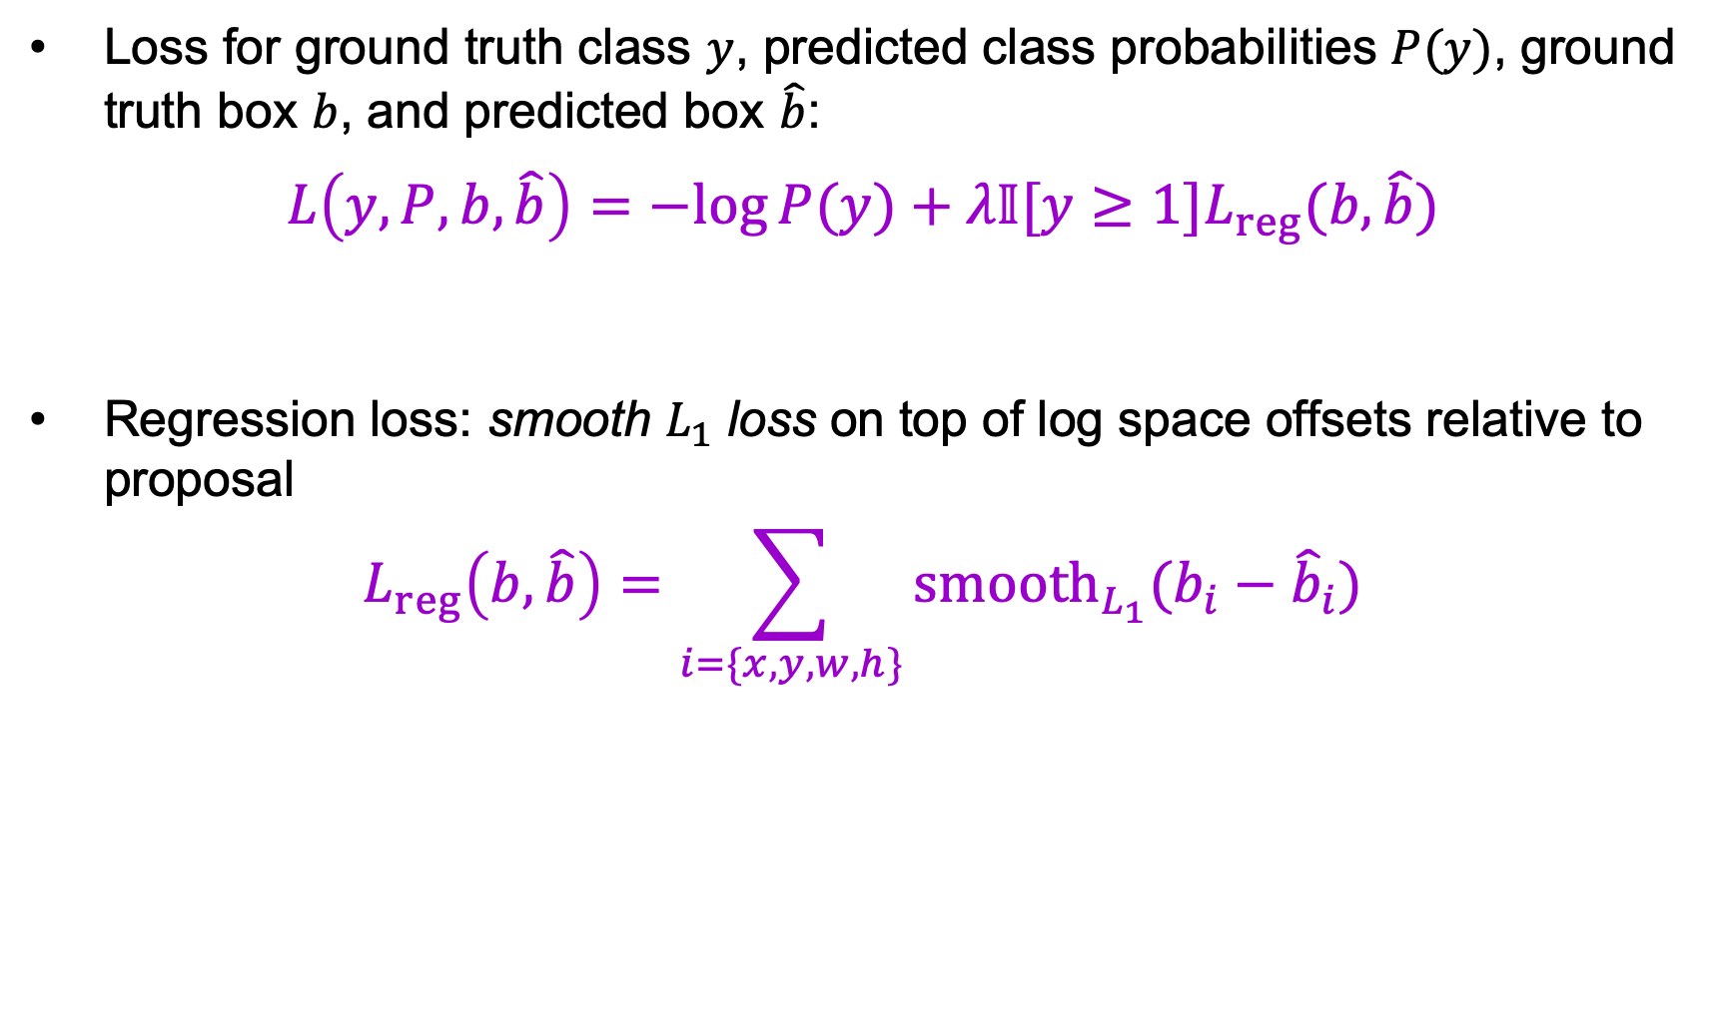
Multi-task loss
Loss for ground truth class $y$, predicted class probabilities $P(y)$, ground truth box $b$, and predicted box $\hat{b}$:
$$L\left(y, P, b,\hat{b}\right)=−log⁡P(y)+λ𝕀[y≥1]L_{reg}(b,\hat{b})$$
Regression loss: smooth $L_{1}$ loss on top of log space offsets relative to proposal
$$L_{reg}\left(b,\hat{b}\right)=\sum_{i=\{x,y,w,h\}}{{smooth}_{L_{1}}(b_{i}−{\hat{b}}_{i}})$$
softmax loss
regression loss

Slide 23
Bounding box regression
Ground truth box
Target offset to predict*
Region proposal
(a.k.a default box, prior, reference, anchor)
Loss
Predicted offset
Predicted box
*Typically in transformed, normalized coordinates

Slide 24
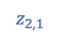
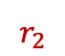
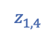
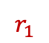
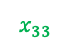
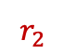
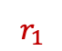
ROI pooling: Backpropagation
Similar to max pooling, but has to take into account overlap of pooling regions
$$r_{1}$$
RoI pooling
$$z_{1,4}$$
$$r_{1}$$
$$z_{2,1}$$
$$x_{33}$$
$$r_{2}$$
$$r_{2}$$
RoI pooling
Feature Map
Source: Ross Girshick

Slide 25


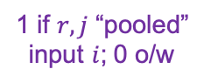
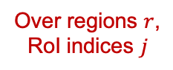
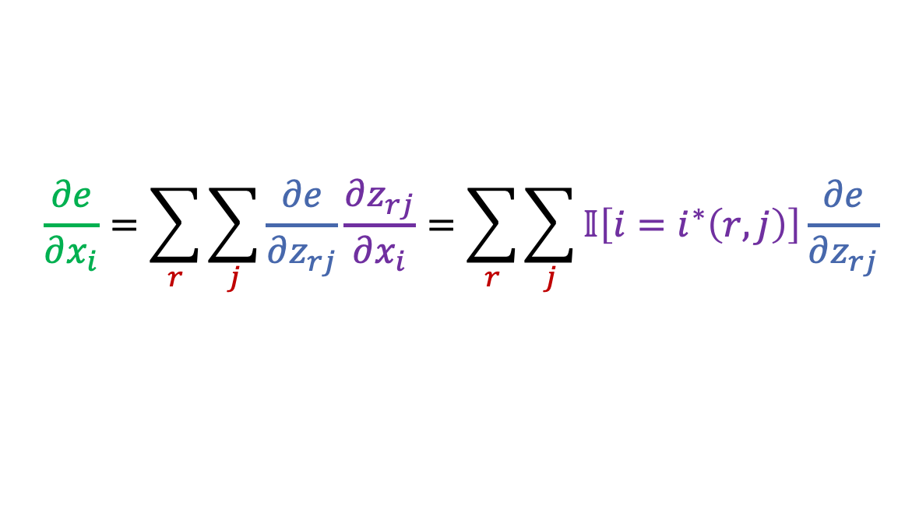
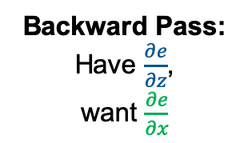
ROI pooling: Backpropagation
Similar to max pooling, but has to take into account overlap of pooling regions
$$r_{1}$$
$$i^{∗}\left(1,4\right)=33$$
$$z_{1,4}$$
$$i^{∗}\left(2,1\right)=33$$
$$r_{1}$$
$$z_{2,1}$$
Backward Pass:
Have $\frac{∂e}{∂z}$,
want $\frac{∂e}{∂x}$
max pooling “switch” (argmax back-pointer)
$$x_{33}$$
$$r_{2}$$
$$r_{2}$$
$$\frac{∂e}{∂x_{i}}=\sum_{r}{\sum_{j}{\frac{∂e}{∂z_{rj}}}}\frac{∂z_{rj}}{∂x_{i}}=\sum_{r}{\sum_{j}{𝕀\left[i=i^{∗}\left(r,j\right)\right]\frac{∂e}{∂z_{rj}}}}$$
Over regions $r$,
RoI indices $j$
1 if $r, j$ “pooled”
input $i$; 0 o/w
Source: Ross Girshick

Slide 26
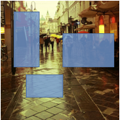
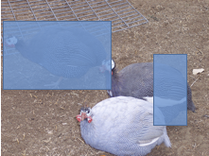
Mini-batch sampling
Sample a few images (e.g., 2)
Sample many regions from each image (64)
...
...
...
...
Sample images
SGD mini-batch
Source: R. Girshick, K. He

Slide 27
Fast R-CNN results
 | Fast R-CNN | R-CNN
Train time (h) | 9.5 | 84
- Speedup | 8.8x
Test time / image | 0.32s | 47.0s
- Test speedup | 146x
mAP | 66.9% | 66.0%
(vs. 53.7% for AlexNet)
Timings exclude object proposal time, which is equal for all methods.
All methods use VGG16.
Source: R. Girshick, K. He
Notes:
These speed improvements do not sacrifice object detection accuracy. In fact, mean average precision is better than the baseline methods due to our improved training.

Slide 28
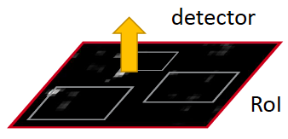
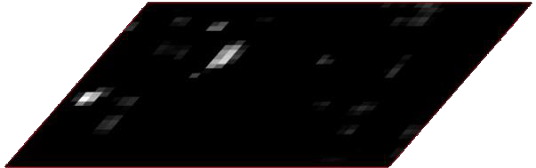
Faster R-CNN
Region proposals
Region Proposal Network
feature map
feature map
CNN
CNN
share features
S. Ren, K. He, R. Girshick, and J. Sun, Faster R-CNN: Towards Real-Time Object Detection with Region Proposal Networks, NIPS 2015

Slide 29
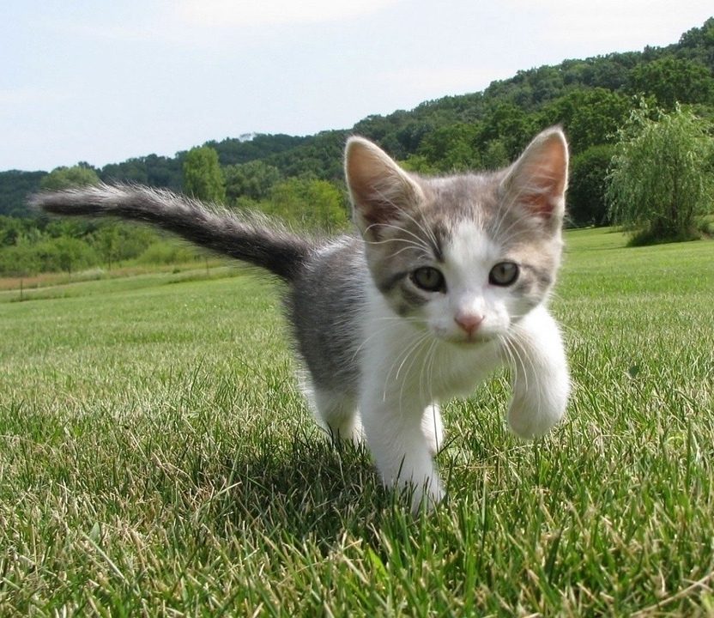
Region proposal network (RPN)
Idea: put an “anchor box” of fixed size over each position in the feature map and try to predict whether this box is likely to contain an object
Anchor is an object?
Figure source: J. Johnson

Slide 30
Region proposal network (RPN)
Idea: put an “anchor box” of fixed size over each position in the feature map and try to predict whether this box is likely to contain an object
Anchor is an object?
Figure source: J. Johnson

Slide 31
Region proposal network (RPN)
Idea: put an “anchor box” of fixed size over each position in the feature map and try to predict whether this box is likely to contain an object
Anchor is an object?
Conv
Figure source: J. Johnson

Slide 32
Region proposal network (RPN)
Idea: put an “anchor box” of fixed size over each position in the feature map and try to predict whether this box is likely to contain an object
Introduce anchor boxes at multiple scales and aspect ratios to handle a wider range of object sizes and shapes
Anchor is object?
Anchor is object?
Anchor is object?
Anchor is object?
Conv
Figure source: J. Johnson

Slide 33
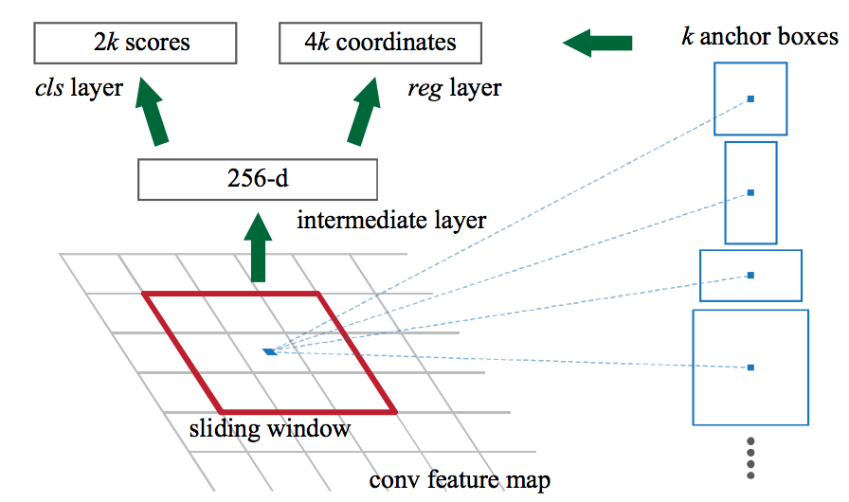
Faster R-CNN RPN design
Slide a small window (3x3) over the conv5 layer
Predict object/no object
Regress bounding box coordinates with reference to anchors (3 scales x 3 aspect ratios)
Notes:
At each sliding-window location, we simultaneously predict multiple region proposals, where the number of maximum possible proposals for each location is denoted as k. So the reg layer has 4k outputs encoding the coordinates of k boxes, and the cls layer outputs 2k scores that estimate probability of object or not object for each proposal

Slide 34

One network, four losses
Classification loss
Bounding-box regression loss
…
Classification loss
Bounding-box regression loss
RoI pooling
proposals
Region Proposal Network
feature map
CNN
Source: R. Girshick, K. He
image

Slide 35
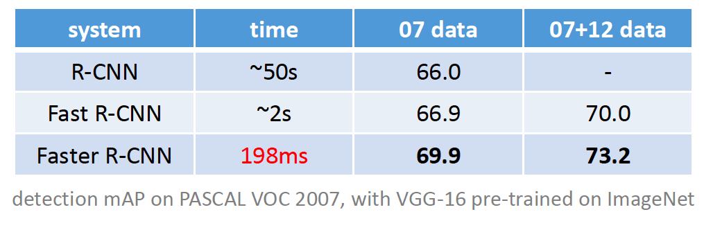
Faster R-CNN results

Slide 36
Object detection progress
Faster R-CNN
Fast R-CNN
Before CNNs
R-CNNv1
After CNNs

Slide 37
Last time: Object detection
Task definition and evaluation
Two-stage detectors
R-CNN
Fast R-CNN
Faster R-CNN

Slide 38
Review: R-CNN
SVMs
Classify regions with SVMs
SVMs
ConvNet
SVMs
ConvNet
Forward each region through ConvNet
ConvNet
Warped image regions
Region proposals
Input image
Notes:
The features are also sent to a linear regressor that improves object localization.
The components outlined in purple are “post hoc” in the sense that they are learned after the convnet weights are trained and forever frozen.

Slide 39
Review: Fast R-CNN
Softmax classification
Bounding-box regression
ROI features
RoI Pooling Layer
Region Proposals
feature map
CNN
image

Slide 40
Review: Faster R-CNN
Softmax classification
Bounding-box regression
ROI features
RoI Pooling Layer
Region Proposals
Region Proposal Network
feature map
CNN
image

Slide 41
Review: RPN
Idea: put an “anchor box” of fixed size over each position in the feature map and try to predict whether this box is likely to contain an object
Anchor is an object?
Figure source: J. Johnson

Slide 42
Review: RPN
Idea: put an “anchor box” of fixed size over each position in the feature map and try to predict whether this box is likely to contain an object
Anchor is an object?
Figure source: J. Johnson

Slide 43
Review: RPN
Idea: put an “anchor box” of fixed size over each position in the feature map and try to predict whether this box is likely to contain an object
Anchor is an object?
Conv
Figure source: J. Johnson

Slide 44
Review: RPN
Idea: put an “anchor box” of fixed size over each position in the feature map and try to predict whether this box is likely to contain an object
Introduce anchor boxes at multiple scales and aspect ratios to handle a wider range of object sizes and shapes
Anchor is object?
Anchor is object?
Anchor is object?
Anchor is object?
Conv
Figure source: J. Johnson

Slide 45
Review: RPN
Slide a small window (3x3) over the conv5 layer
Predict object/no object
Regress bounding box coordinates with reference to anchors (3 scales x 3 aspect ratios)
Notes:
At each sliding-window location, we simultaneously predict multiple region proposals, where the number of maximum possible proposals for each location is denoted as k. So the reg layer has 4k outputs encoding the coordinates of k boxes, and the cls layer outputs 2k scores that estimate probability of object or not object for each proposal

Slide 46
Outline
Task definition and evaluation
Two-stage detectors
R-CNN
Fast R-CNN
Faster R-CNN
Single-stage and multi-resolution detectors

Slide 47
Streamlined detection architectures
The Faster R-CNN pipeline separates proposal generation and region classification
Is it possible to do detection in one shot?
Region Proposals
RPN
Classification + Regression
Conv feature map of the entire image
RoI features
Detections
RoI pooling
Classification + Regression
Conv feature map of the entire image
Detections

Slide 48
YOLO
Divide the image into a coarse grid and directly predict class label and a few candidate boxes for each grid cell
J. Redmon, S. Divvala, R. Girshick, and A. Farhadi, You Only Look Once: Unified, Real-Time Object Detection, CVPR 2016

Slide 49
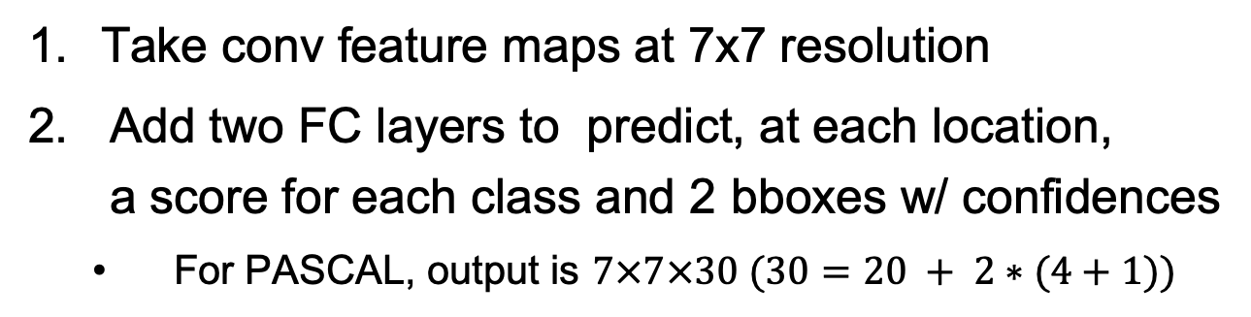
YOLO
Take conv feature maps at 7x7 resolution
Add two FC layers to predict, at each location, a score for each class and 2 bboxes w/ confidences
For PASCAL, output is $7×7×30 (30=20 + 2∗(4+1))$
J. Redmon, S. Divvala, R. Girshick, and A. Farhadi, You Only Look Once: Unified, Real-Time Object Detection, CVPR 2016

Slide 50
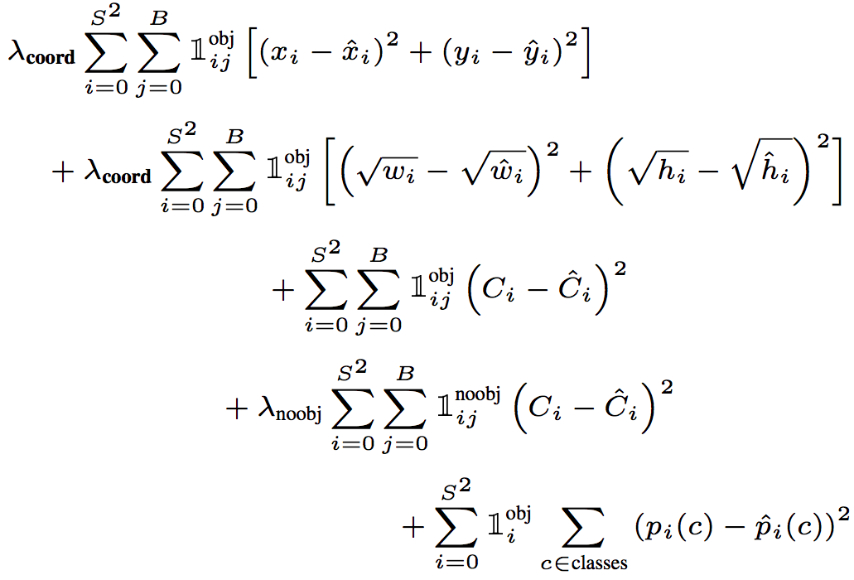
YOLO
Objective function:
Regression
Object/no object confidence
Class prediction
Notes:
At training time we only want one bounding box predictor to be responsible for each object. We assign one predictor to be “responsible” for predicting an object based on which prediction has the highest current IOU with the ground truth.

Slide 51
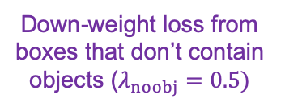
YOLO
Objective function:
Cell i contains object, predictor j is responsible for it
Small deviations matter less for larger boxes than for smaller boxes
Confidence for object
Confidence for no object
Down-weight loss from boxes that don’t contain objects ($λ_{noobj}=0.5)$
Class probability
Notes:
At training time we only want one bounding box predictor to be responsible for each object. We assign one predictor to be “responsible” for predicting an object based on which prediction has the highest current IOU with the ground truth.

Slide 52
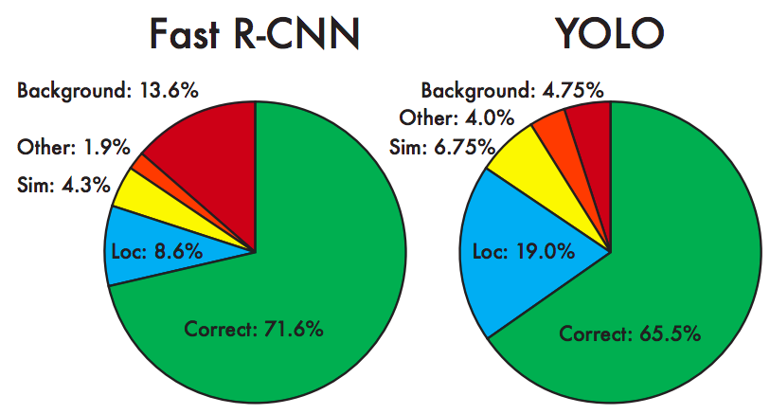
YOLO: Results
Each grid cell predicts only two boxes and can only have one class – this limits the number of nearby objects that can be predicted
Localization accuracy suffers compared to Fast(er) R-CNN due to coarser features, errors on small boxes
7x speedup over Faster R-CNN (45-155 FPS vs. 7-18 FPS)
Performance on PASCAL 2007

Slide 53
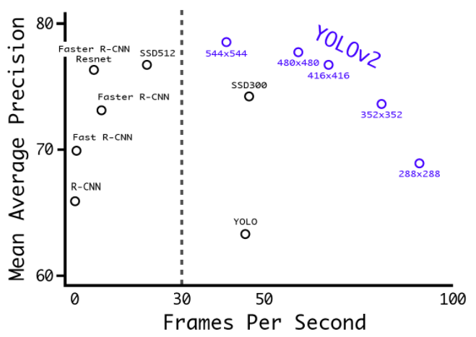
YOLO v2
Remove FC layer, do convolutional prediction with anchor boxes instead
Increase resolution of input images and conv feature maps
Improve accuracy using batch normalization and other tricks
VOC 2007 results
YouTube demo
J. Redmon and A. Farhadi, YOLO9000: Better, Faster, Stronger, CVPR 2017

Slide 54
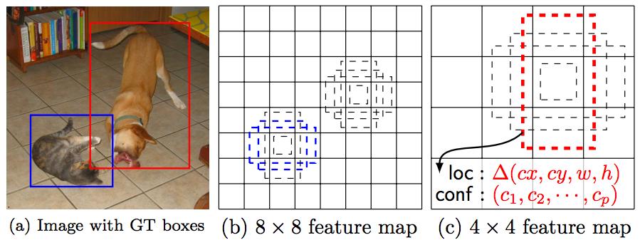
Multi-resolution prediction: SSD
Predict boxes of different size from different conv maps
Each level of resolution has its own predictor
W. Liu, D. Anguelov, D. Erhan, C. Szegedy, S. Reed, C.-Y. Fu, and A. Berg, SSD: Single Shot MultiBox Detector, ECCV 2016

Slide 55
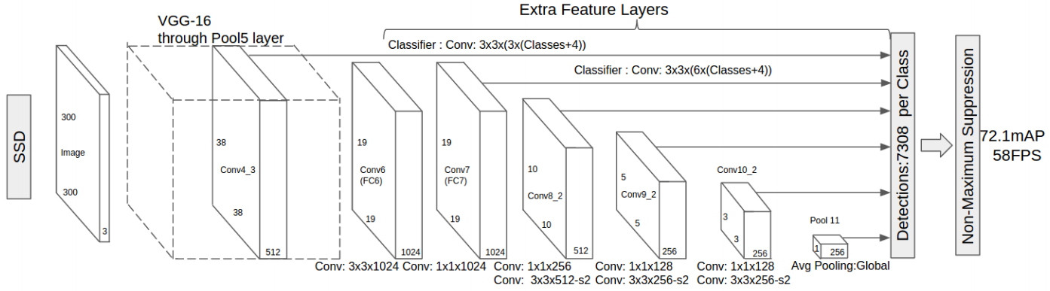
Multi-resolution prediction: SSD
Predict boxes of different size from different conv maps
Each level of resolution has its own predictor
W. Liu, D. Anguelov, D. Erhan, C. Szegedy, S. Reed, C.-Y. Fu, and A. Berg, SSD: Single Shot MultiBox Detector, ECCV 2016

Slide 56
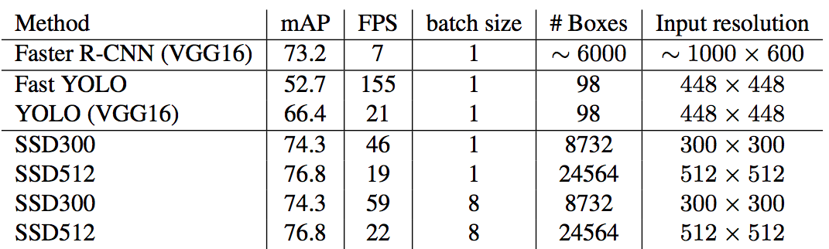
SSD: Results (PASCAL 2007)
More accurate and faster than YOLO and Faster R-CNN

Slide 57
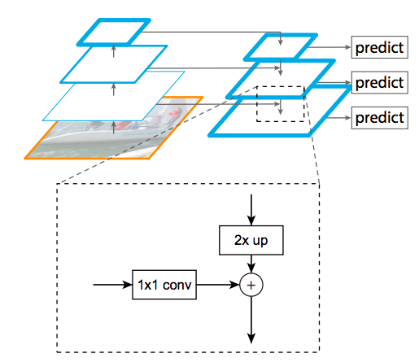
Feature pyramid networks
Improve predictive power of lower-level feature maps by adding contextual information from higher-level feature maps
Predict different sizes of bounding boxes from different levels of the pyramid (but share parameters of predictors)
T.-Y. Lin, P. Dollar, R. Girshick, K. He, B. Hariharan, and S. Belongie, Feature pyramid networks for object detection, CVPR 2017

Slide 58
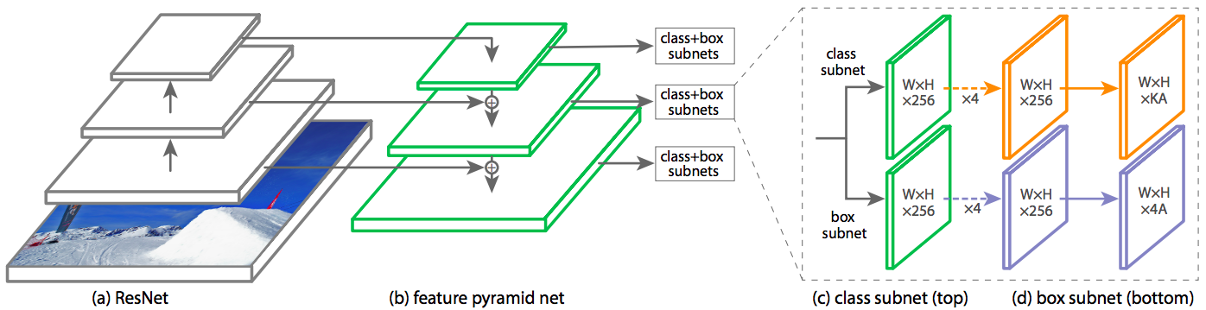
RetinaNet
Combine feature pyramid network with focal loss to reduce the standard cross-entropy loss for well-classified examples
T.-Y. Lin, P. Goyal, R. Girshick, K. He, P. Dollar, Focal loss for dense object detection, ICCV 2017

Slide 59
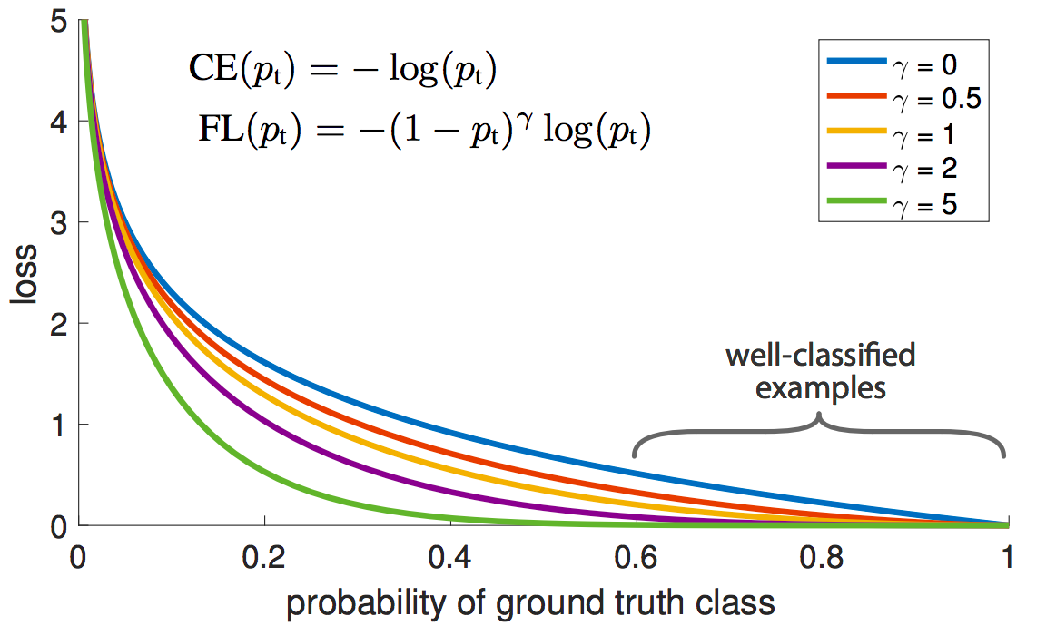
RetinaNet
Combine feature pyramid network with focal loss to reduce the standard cross-entropy loss for well-classified examples
T.-Y. Lin, P. Goyal, R. Girshick, K. He, P. Dollar, Focal loss for dense object detection, ICCV 2017
Notes:
From the paper: (1) When an example is misclassified and pt is small, the modulating factor is near 1 and the loss is unaffected. As pt → 1, the factor goes to 0 and the loss for well-classified examples is down-weighted. (2) The focusing parameter γ smoothly adjusts the rate at which easy examples are downweighted. When γ = 0, FL is equivalent to CE, and as γ is increased the effect of the modulating factor is likewise increased (we found γ = 2 to work best in our experiments)

Slide 60
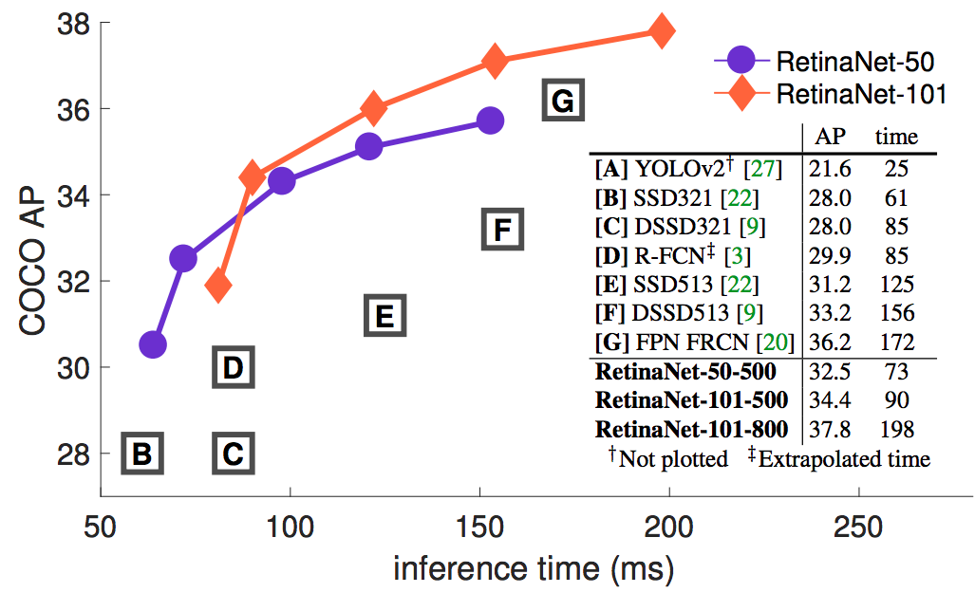
RetinaNet: Results
T.-Y. Lin, P. Goyal, R. Girshick, K. He, P. Dollar, Focal loss for dense object detection, ICCV 2017
Notes:
From the paper: (1) When an example is misclassified and pt is small, the modulating factor is near 1 and the loss is unaffected. As pt → 1, the factor goes to 0 and the loss for well-classified examples is down-weighted. (2) The focusing parameter γ smoothly adjusts the rate at which easy examples are downweighted. When γ = 0, FL is equivalent to CE, and as γ is increased the effect of the modulating factor is likewise increased (we found γ = 2 to work best in our experiments)

Slide 61
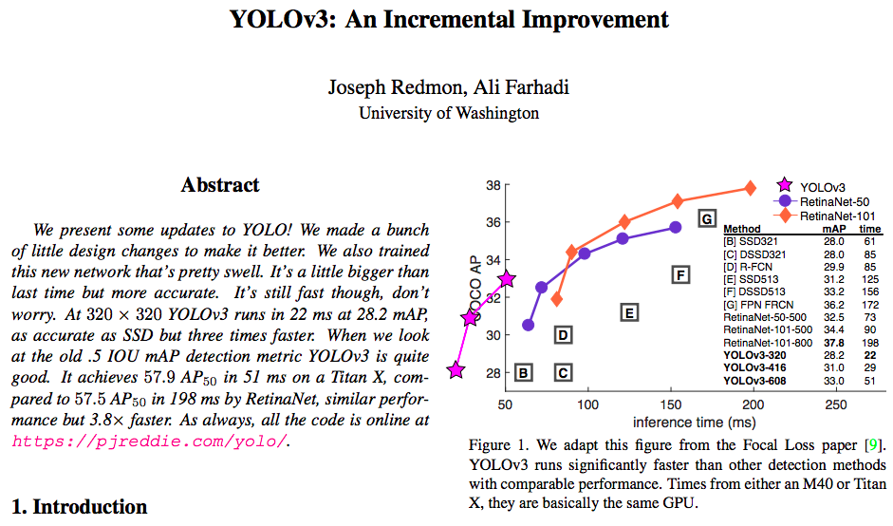
YOLO v3
https://pjreddie.com/media/files/papers/YOLOv3.pdf

Slide 62
Summary so far
R-CNN: region proposals + CNN on cropped, resampled regions
Fast R-CNN: region proposals + RoI pooling on top of a conv feature map
Faster R-CNN: RPN + RoI pooling
Next generation of detectors: YOLO, SSD, RetinaNet
Direct prediction of BB offsets, class scores on top of conv feature maps
Get better context by combining feature maps at multiple resolutions
Most recent trends: architectures borrowed from dense prediction, transformers

Slide 63
Outline
Task definition and evaluation
Two-stage detectors
R-CNN
Fast R-CNN
Faster R-CNN
Single-stage and multi-resolution detectors
Recent trends

Slide 64
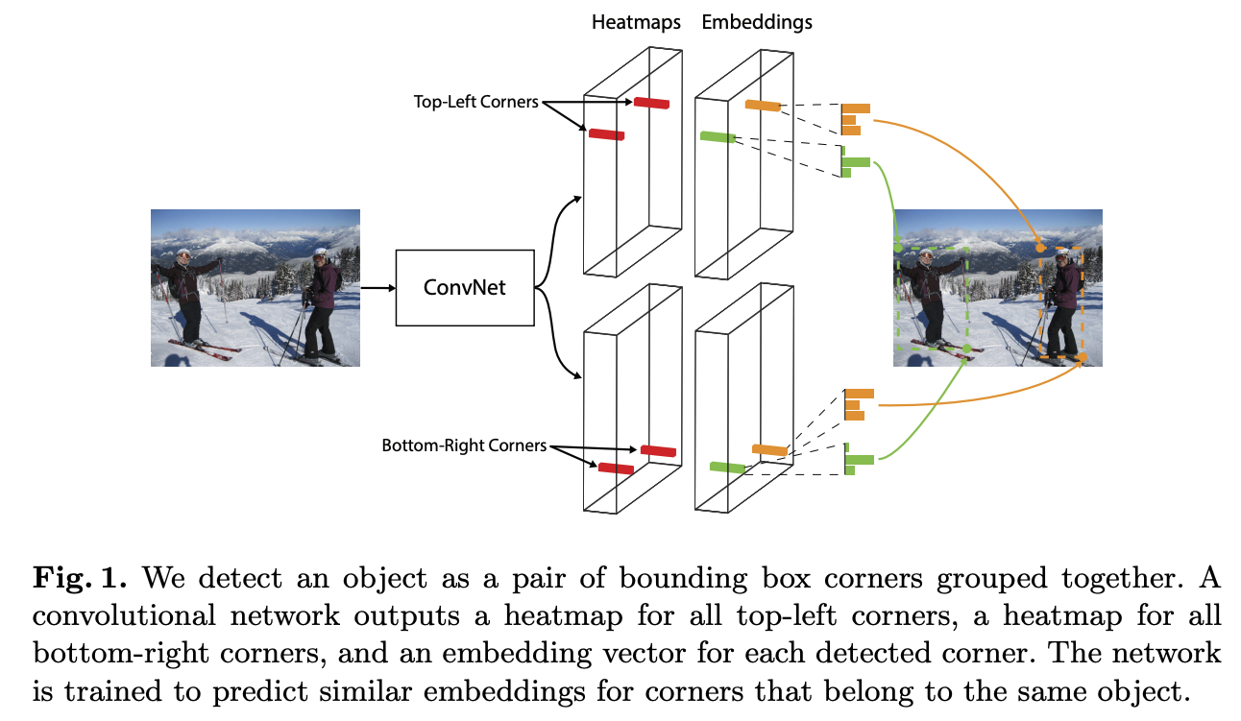
CornerNet
H. Law and J. Deng, CornerNet: Detecting Objects as Paired Keypoints, ECCV 2018
Notes:
We detect an object as a pair of bounding box corners grouped together. A convolutional network outputs a heatmap for all top-left corners, a heatmap for all bottom-right corners, and an embedding vector for each detected corner. The network is trained to predict similar embeddings for corners that belong to the same object.

Slide 65
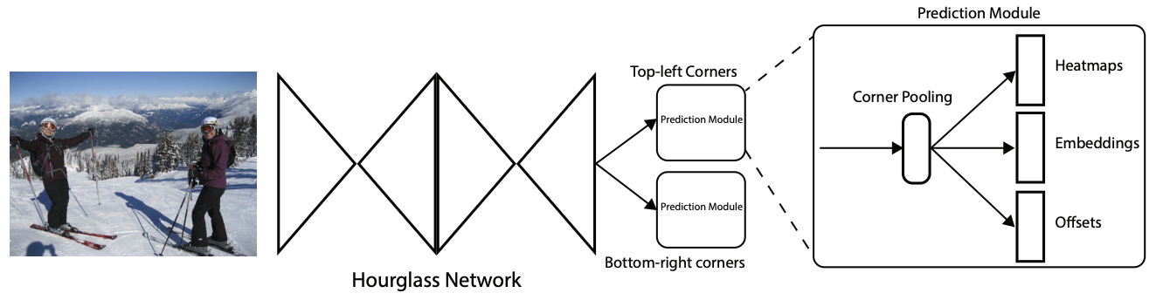
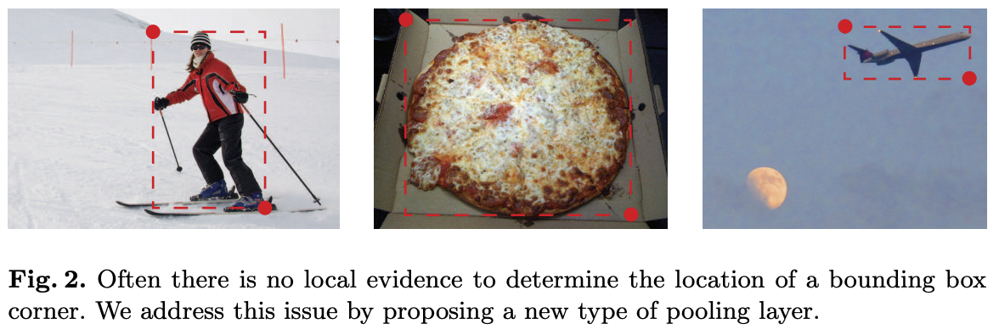
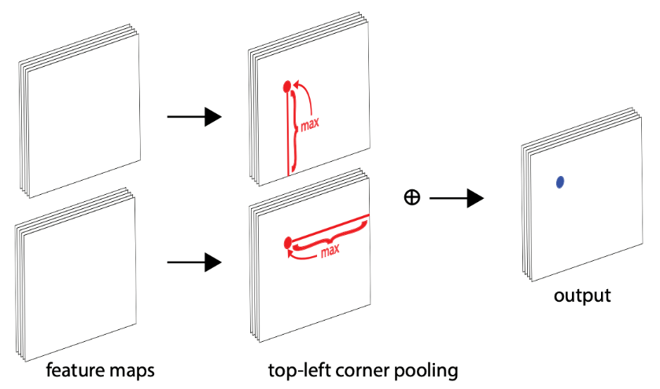
CornerNet
H. Law and J. Deng, CornerNet: Detecting Objects as Paired Keypoints, ECCV 2018
Notes:
We detect an object as a pair of bounding box corners grouped together. A convolutional network outputs a heatmap for all top-left corners, a heatmap for all bottom-right corners, and an embedding vector for each detected corner. The network is trained to predict similar embeddings for corners that belong to the same object.

Slide 66

CenterNet
Use an additional center point to verify predictions:
K. Duan et al. CenterNet: Keypoint Triplets for Object Detection, ICCV 2019

Slide 67

CenterNet
K. Duan et al. CenterNet: Keypoint Triplets for Object Detection, ICCV 2019

Slide 68

CenterNet
K. Duan et al. CenterNet: Keypoint Triplets for Object Detection, ICCV 2019

Slide 69


Detection Transformer (DETR)
N. Carion et al., End-to-end object detection with transformers, ECCV 2020
Notes:
DETR uses a conventional CNN backbone to learn a 2D representation of an input image. The model flattens it and supplements it with a positional encoding before passing it into a transformer encoder. A transformer decoder then takes as input a small fixed number of learned positional embeddings, which we call object queries, and additionally attends to the encoder output. We pass each output embedding of the decoder to a shared feed forward network (FFN) that predicts either a detection (class and bounding box) or a “no object” class.

